Slide 1

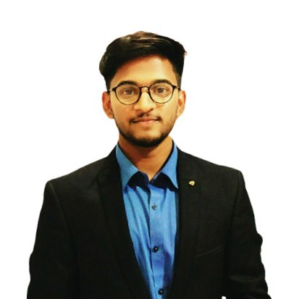




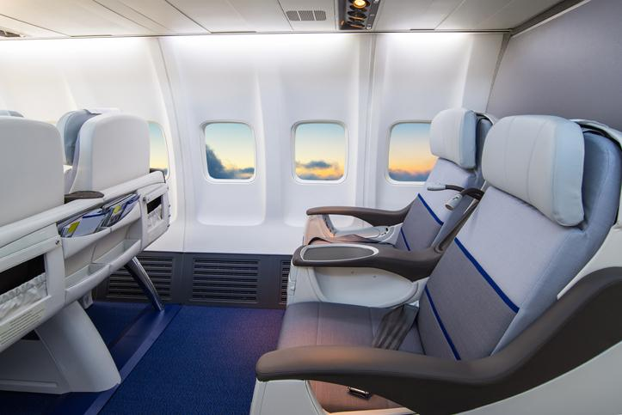
Zhenning
Li
Shouvik
Das Gupta
Enrico
Burigana
Vincent
Wilmet
Alban
Veaute
14/02/2022 - 18/02/2022
Hackathon by
Airplane
Interior Services

Slide 2
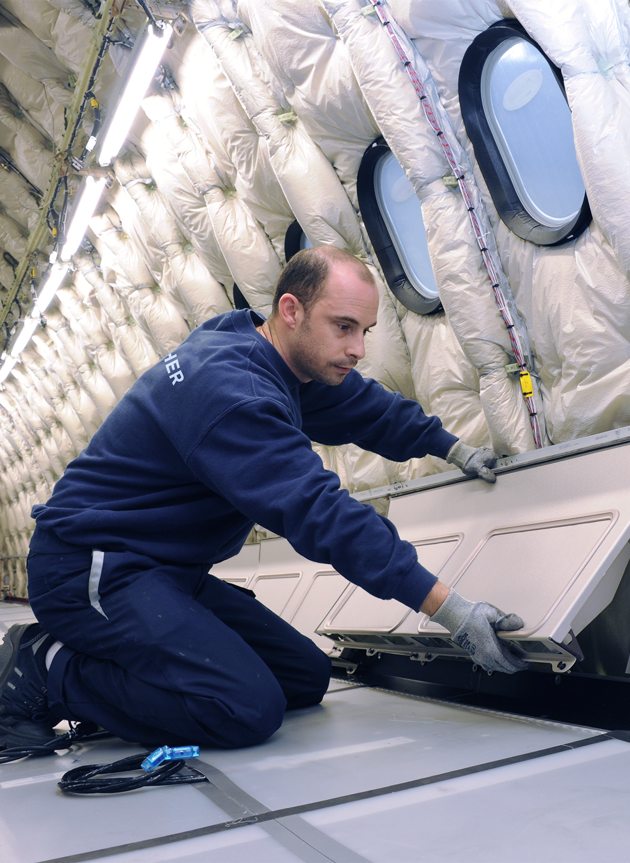
Market Study

Slide 3
A MARKET WITH HIGH ENTRY AND TECHNICAL BARRIERS
Various customers
Airlines
Private jet manufacturer
Military industry
High barrier to entry
Requires a know-how
Technical and legal constraints
A strong brand name
Scattered suppliers
Very different suppliers for each part
Actors with a know-how
Market intensity
A need to be present on all components
A regulated environment for safety
Some airlines have internalized the design
Regulation
Safety certification on each part of the aircraft
Economic constraint
Strong competitors
In-house designer (Delta)
Specialized companies (Collins Aerospace)
Individual designer (M. Pierrejean)
A strong concentration of actors
It is almost impossible to cover the production line for all parts of the aircraft interior for an interior designer
The challenges of integrating each part of the aircraft are numerous in order to obtain an overall coherence
These characteristics make this market a competitive sector with few players
Sources : businessinsider.com, pierrejeanvision.com, Linkedin
Notes:
Alban

Slide 4
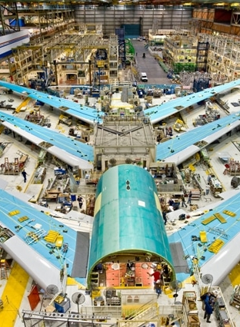
Methodology
Notes:
buri

Slide 5



OUR PIPELINE, FROM SCRAPING TO SENTIMENT ANALYSIS USING GOEMOTIONS
Data from two different types of pages on the website SkyTrax:
Airline Reviews: content less specific for our task, but abundant
Seat Reviews: content tailored on our needs, but very few available
Also, list of low cost carriers from Wikipedia.
Web Scraping
using BeautifulSoup
Topic Identification
using Latent Dirichlet Allocation (LDA)
Cleaned and lemmatized reviews are analyzed to identify topics of interest i.e. collection of words that appear frequently together.
Each document is classified into one of 8 topics we identified.
Reviews are analyzed by a state-of-the-art BERT-based emotions classifier.
Each review is labeled with one or more of 27 sentiments.
Sentiment Analysis
using GoEmotions by Google Research
Notes:
buri

Slide 6
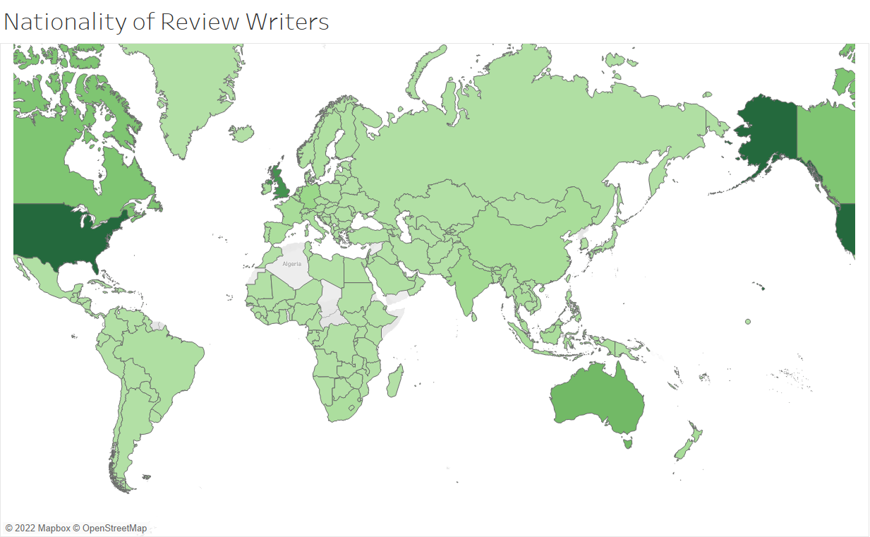
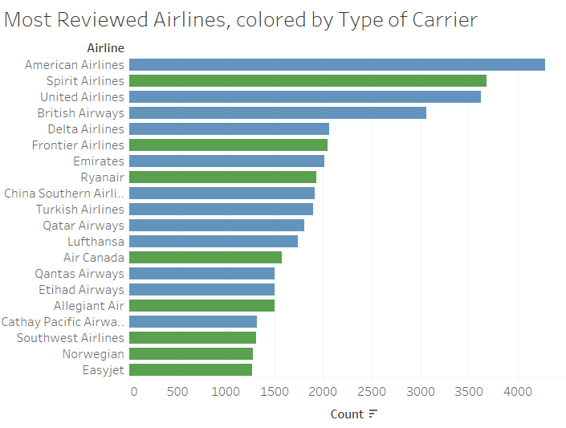
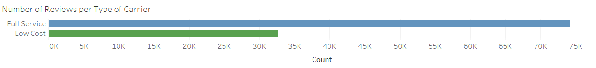
WEB SCRAPED MOSTLY REVIEWS BY ENGLISH-SPEAKERS FLYING ON FULL SERVICE CARRIERS
Notes:
buri

Slide 7


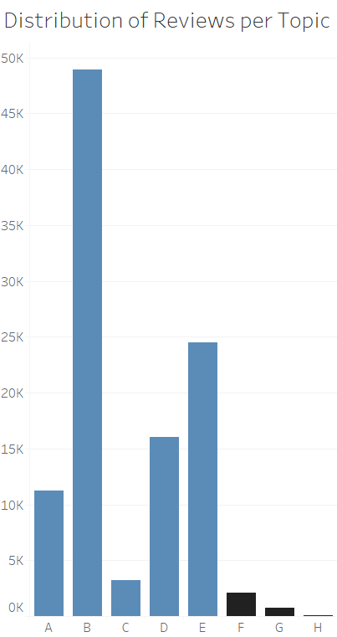
IDENTIFIED EIGHT TOPICS, FIVE ARE RELATED TO INTERIOR SERVICES
seat
plane
flight
good
class
business
hour
time
Useful for sentiment analysis
flight
extra
crew
food
meal
economy
plane
minute
leg
row
service
seat
food
water
flight
delay
Unrelated to task
front
passenger
time
customer
service
weather
airport
passanger
people
room
cabin
revie
spirit
drink
staff
gate
Seating
only
Seating
+ Service
Seating
+ Service
Seating + TV
+ Delay
A
B
C
D
experience
bad
bag
luggage
check
boarding
call
non
time
money
baggage
staff
online
ticket
dirty
wizzair
ticket
day
check
terminal
agent
card
minus
existent
service
customer
extra
hand
pass
counter
simple
select
airline
flight
free
airline
employee
line
button
cold
Business Class
Luggage
+ Check In
Check In
Customer
Service
E
F
G
H
Notes:
shouvik

Slide 8

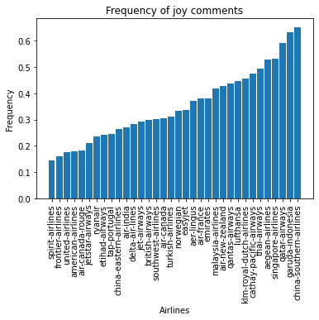

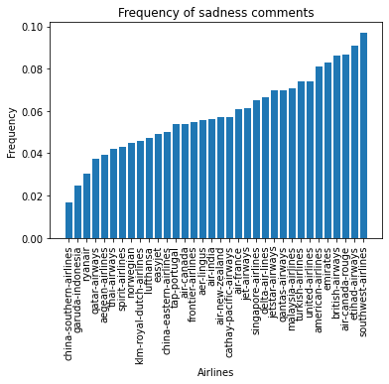

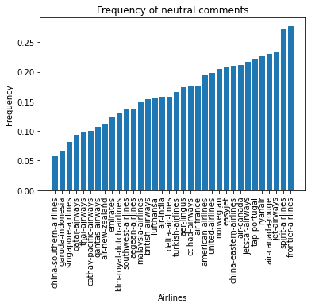

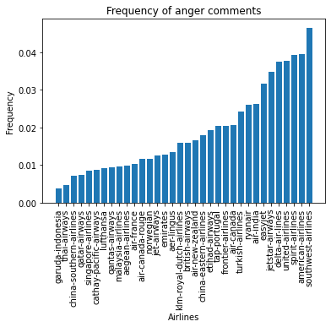

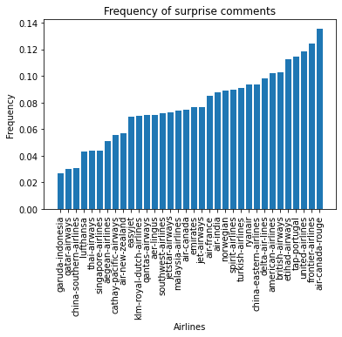

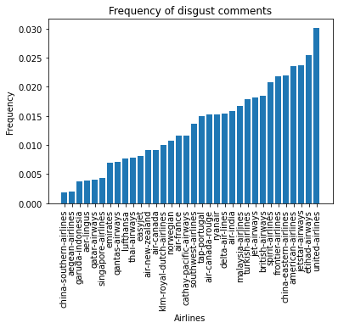
EACH AIRLINE PROVOKES VERY DIFFERENT FEELINGS
Notes:
shouvik

Slide 9
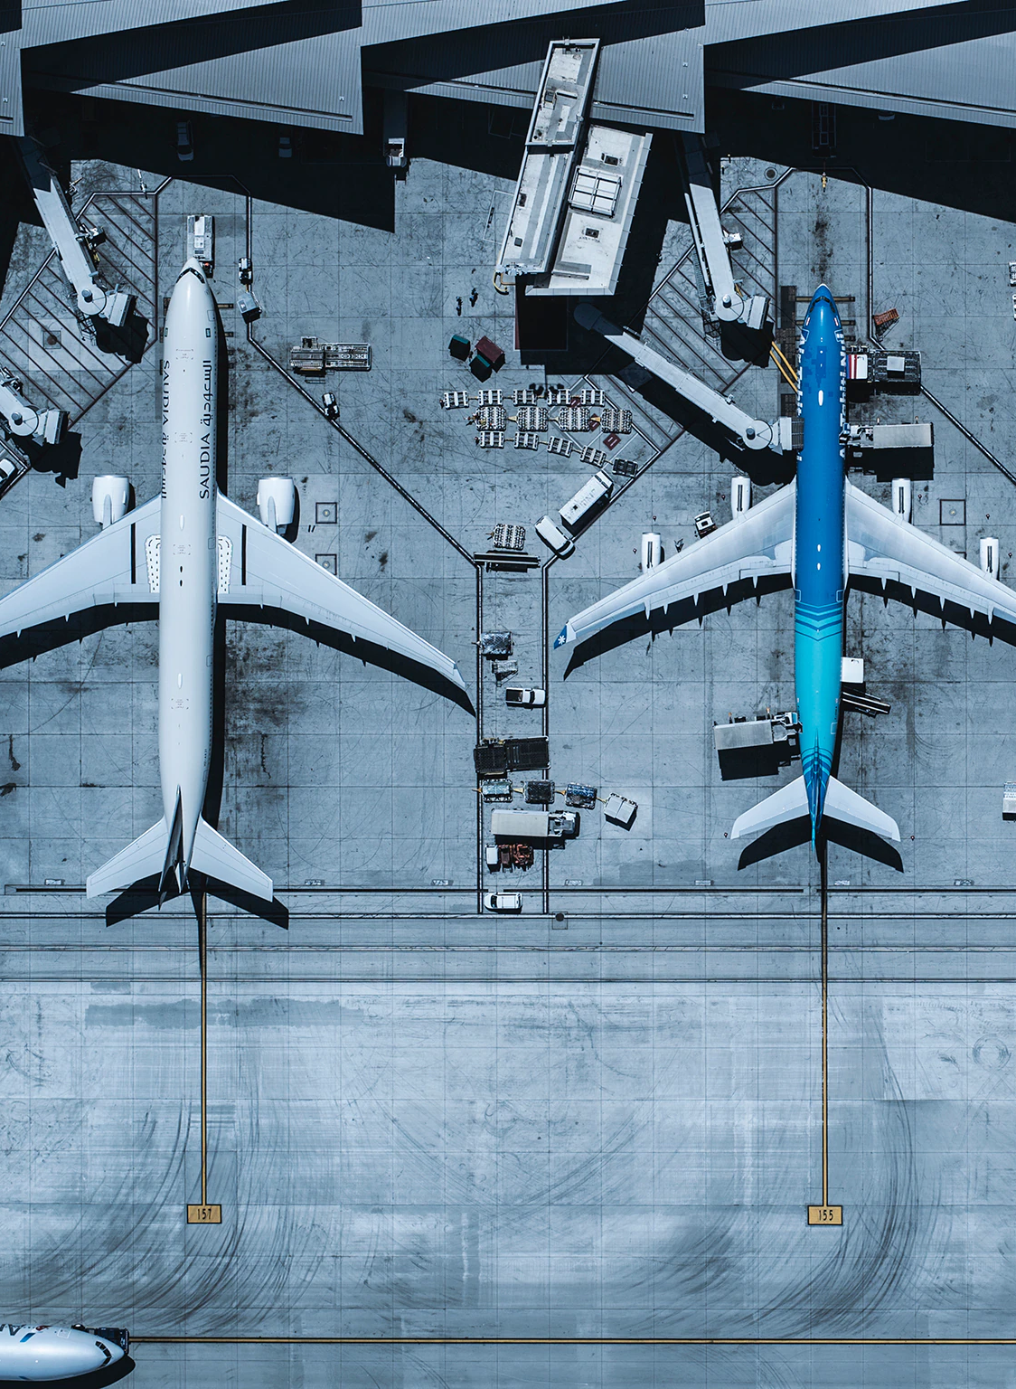
Insights
Notes:
vincent

Slide 10
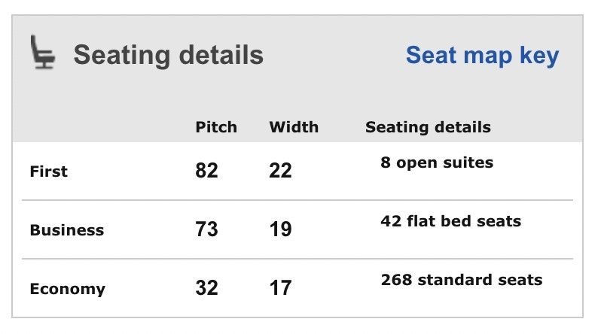
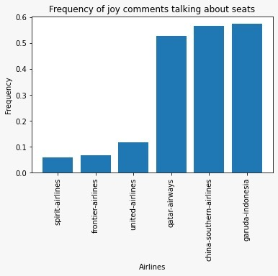
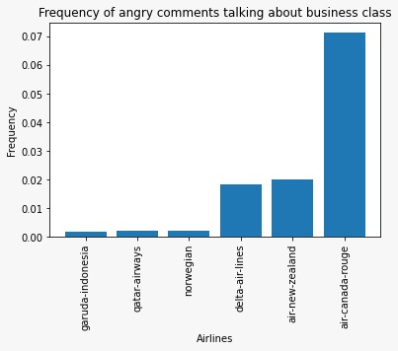
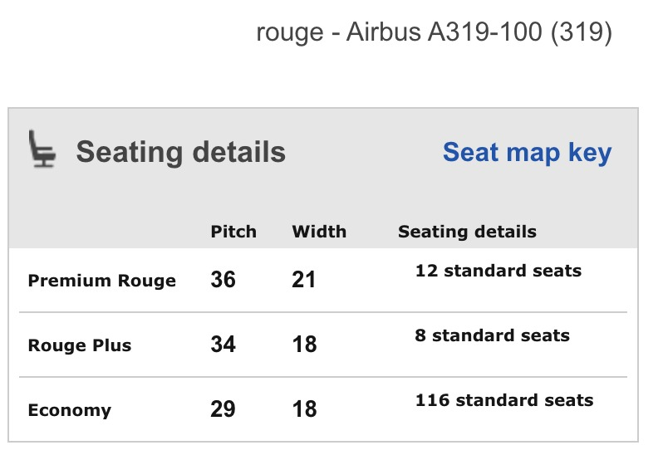
EASILY FIND WHICH AIRLINES HAVE THE BEST AND WORST COMMENTS ON A CERTAIN TOPIC
Garuda Indonesia
Comments about Business Class – Comments % per Emotion
Air Canada Rouge
Imitate Best Practices, Avoid Bad Examples
The parameters on which to act to improve each element are often obvious: a seat with large recline angle, made of a soft material and with strong lumbar support is clearly preferable.
The issue is that all this comforts come at a cost. Using our pipeline, we can easily identify the characteristics of each company which trigger customers’ positive and negative reactions. Once we know who is implementing the best and the worst practices, we can dig into the technical details of those only.
Notes:
vincent

Slide 11
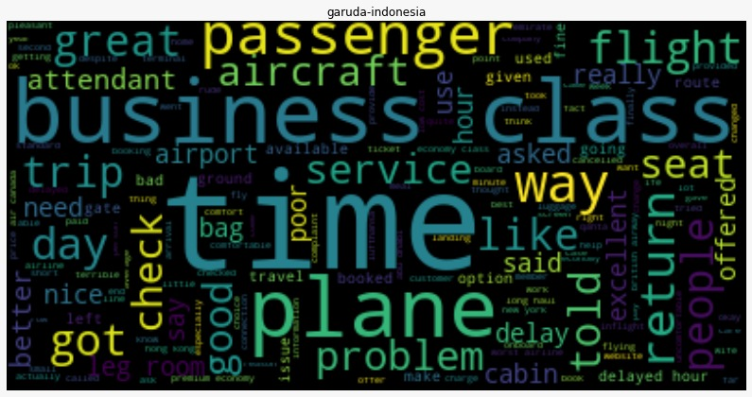
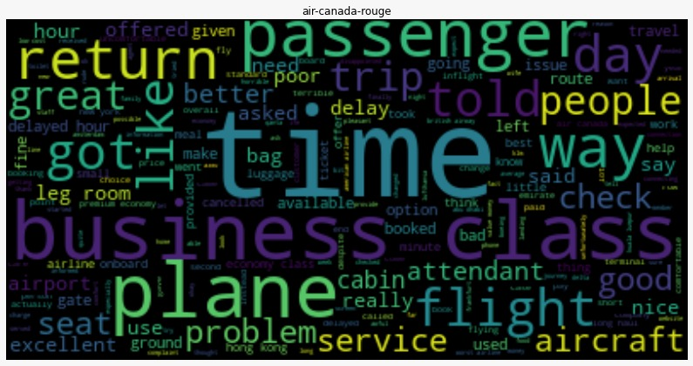
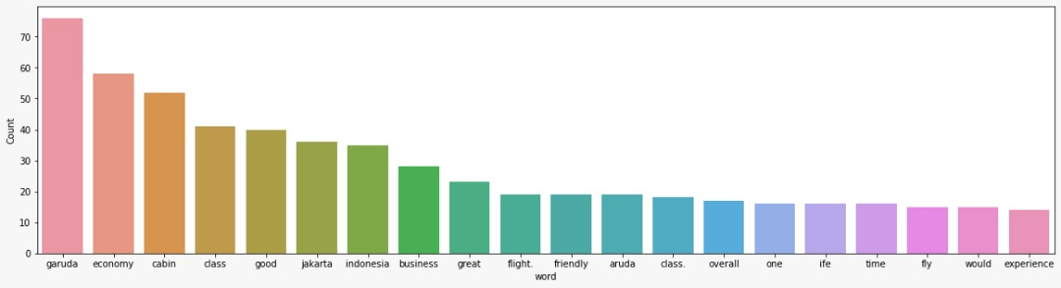
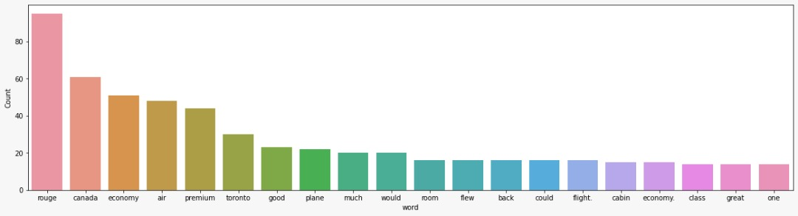
JOY AND ANGER COMMENT FREQUENCY REGARDING BUSINESS CLASS SEATS BY AIRLINE
Airline with good reviews
Airline with bad reviews
Imitate Best Practices, Avoid Bad Examples
We can see the same thing that made Garuda good, made Air Canada bad.
For the reviews of people who are in business class, angry and on Garuda Airlines, they uniquely liked: upgrades, check, friendly
For the reviews of people who are in business class, angry and on Air Canada airlines, they uniquely disliked: room, cabin, people, attendant
Notes:
vincent/victor

Slide 12
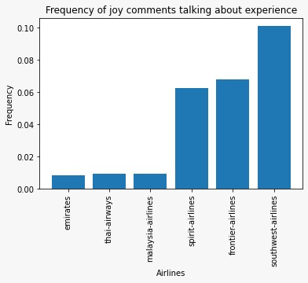
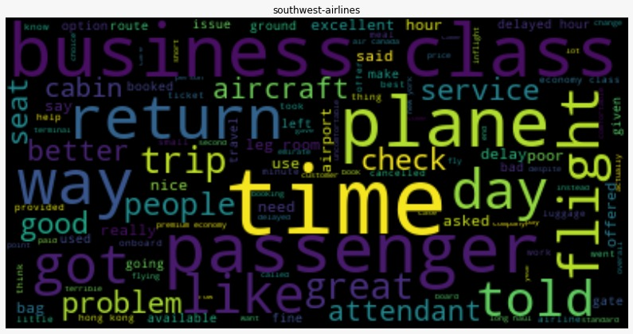
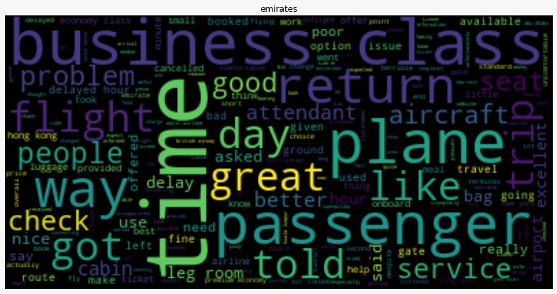
JOY COMMENT FREQUENCY REGARDING EXPERIENCE BY AIRLINE
Comments about Experience
The Good
The Bad
Imitate Best Practices, Avoid Bad Examples
We can see the same thing that made Southwest good, made Emirates bad.
What we see in these graphics is that Southwest creates the best experience for its passengers because of topics like: problem, attendant
What we see in these graphics is that Emirates creates a bad experience for its passengers because of topics like: service
Notes:
vincent/victor

Slide 13
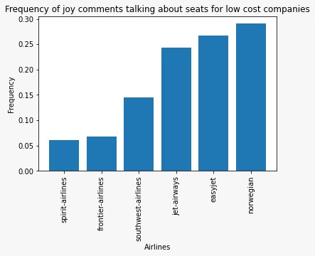
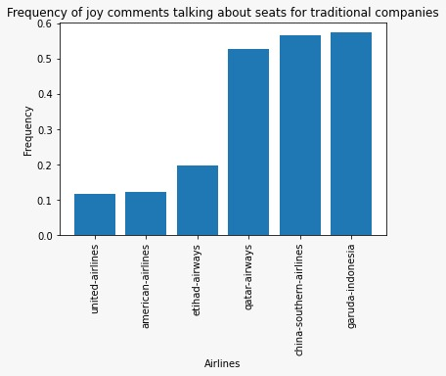
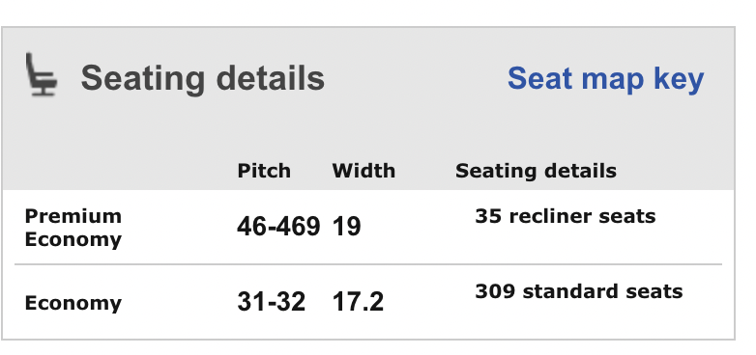
FULL SERVICE VS LOW COST CARRIER COMMENTS REGARDING JOY COMMENTS
Comments about Service Carrier Types – Comments % per Emotion
Garuda Indonesia
Norwegian
Imitate Best Practices, Avoid Bad Examples
This further confirms our insights that for low cost carriers and full service carriers, the best performing airlines are ones that have disproportionately large seating dimensions.
The industry average is (29,17) for Economy and (34,19) for Business travelers.
Notes:
vincent

Slide 14
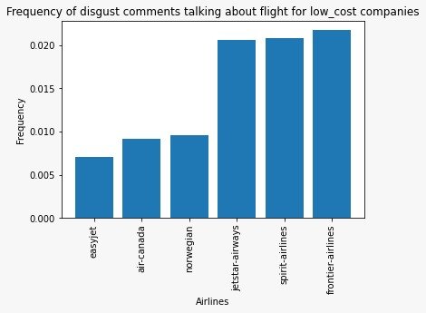
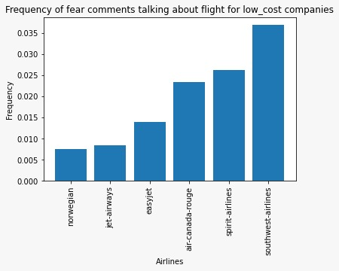
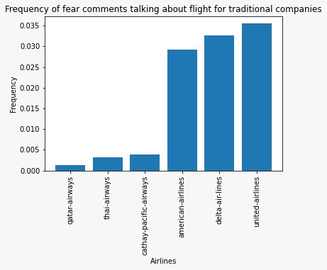
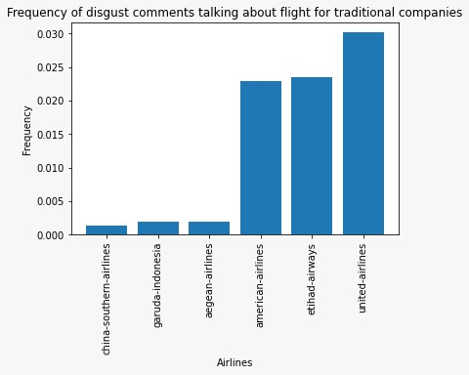
FEAR AND DISGUST COMMENTS REGARDING CARRIER TYPES
Low Cost Carriers
Full Service Carriers
Imitate Best Practices, Avoid Bad Examples
Spirit consistently performs poorly for reviews about fear and disgust.
United consistently performs poorly for reviews about fear and disgust.
However, the airlines that receive the least fear/disgust vary.

Slide 15
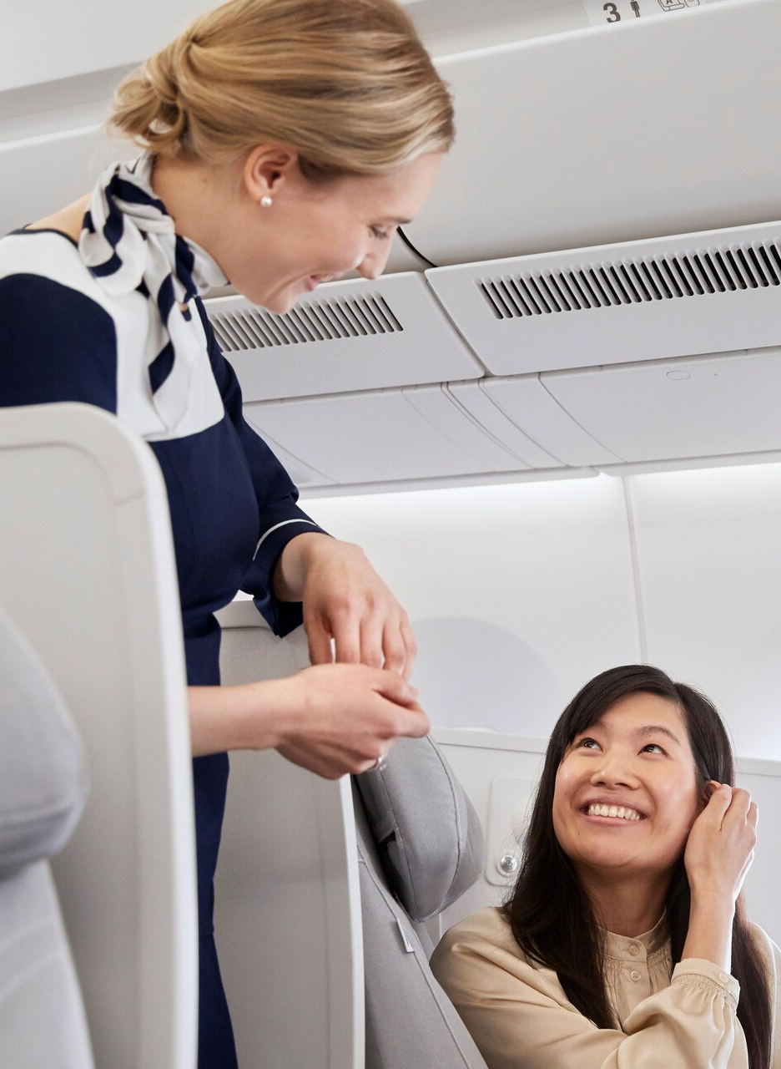
Limitations &
Future Improvements
Notes:
buri

Slide 16
OUR ANALYSIS COULD USE MORE TYPES OF DATA
Our current analysis uses the NLP pipeline and the classification among low cost and full service carriers.
However, several other data would be available, and in particular:
Layout of the aircraft: useful to look for correlation between customer experience and number of middle seats per row/number of aisles.
Seat Type of the reviewer: important to reach a new level of granularity, conducting the analysis on Economy or Business class only.
Type of Aircraft: it may be unfair to compare reviews of very old and latest aircrafts, as their interior design has inevitably improved over time.
A limitation of our work might be that we are only considering reviews written in English and with length <152 (required by GoEmotions).
However, given the highly standardized design of aircrafts around the world, we think this corpus may be representative of all customers’ tastes.
Notes:
buri

Slide 17
Zhenning
Li
Shouvik
Das Gupta
Enrico
Burigana
Vincent
Wilmet
Alban
Veaute
Hackathon by
Thanks for your attention

